Slide 1
using foursquare api to Find the best location to open a pizza store in Toronto
Nicholas Boldt

Slide 2
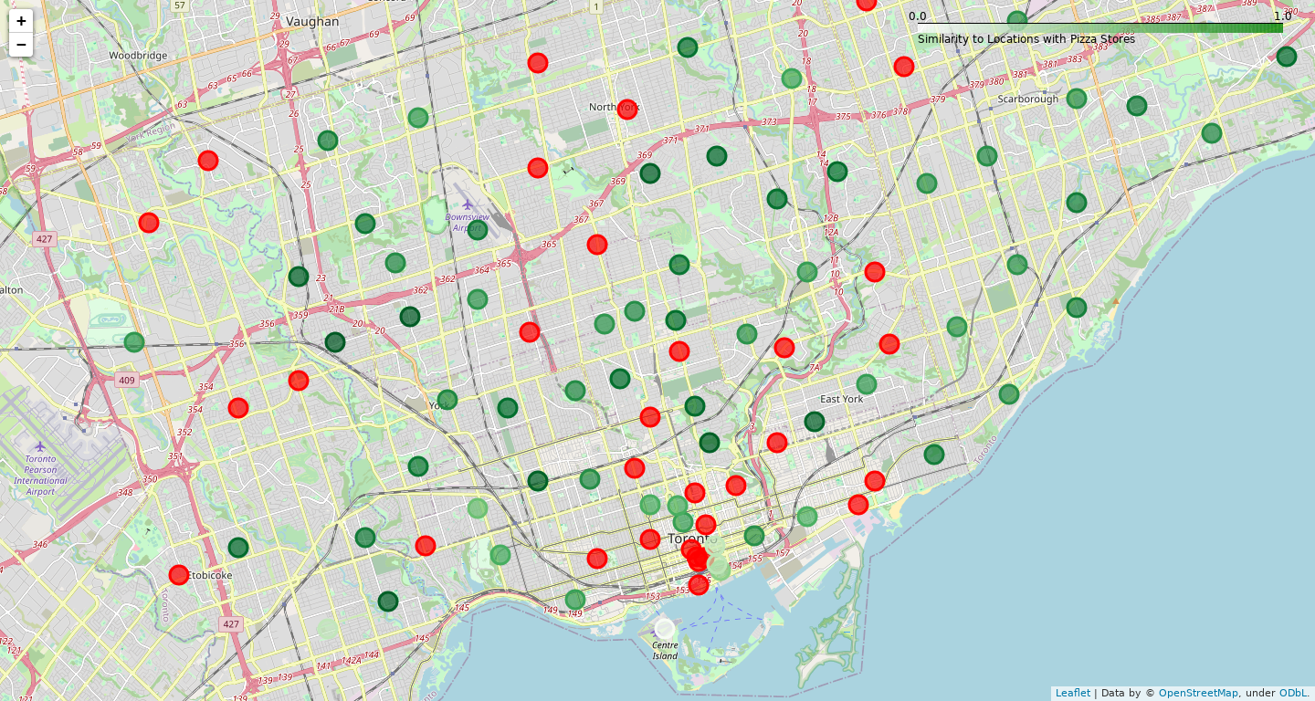
Using Euclidian Distance As Dissimilarity Metric

Slide 3
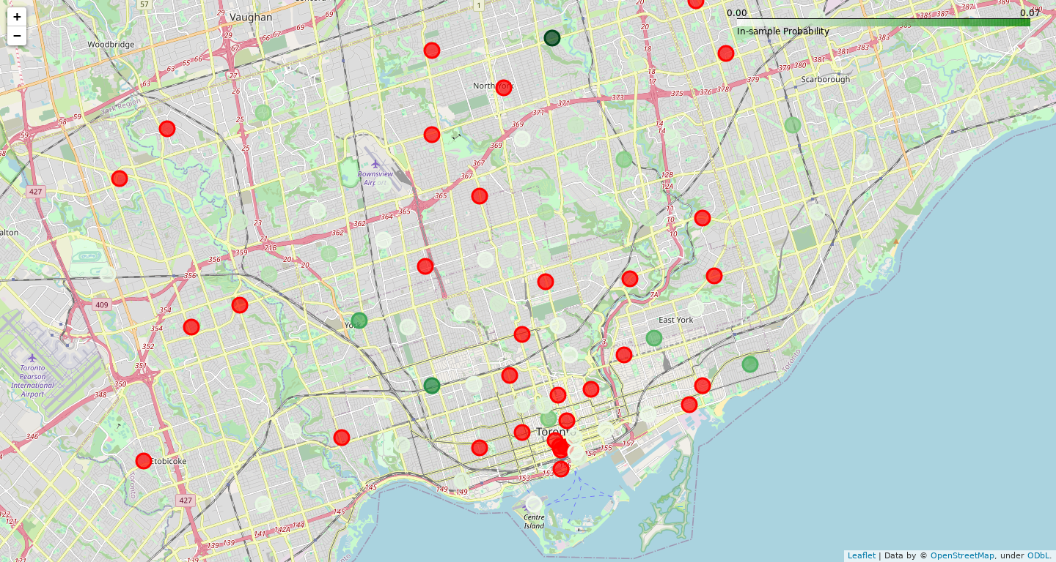
Using In-Sample
Logistic Regression

Slide 4
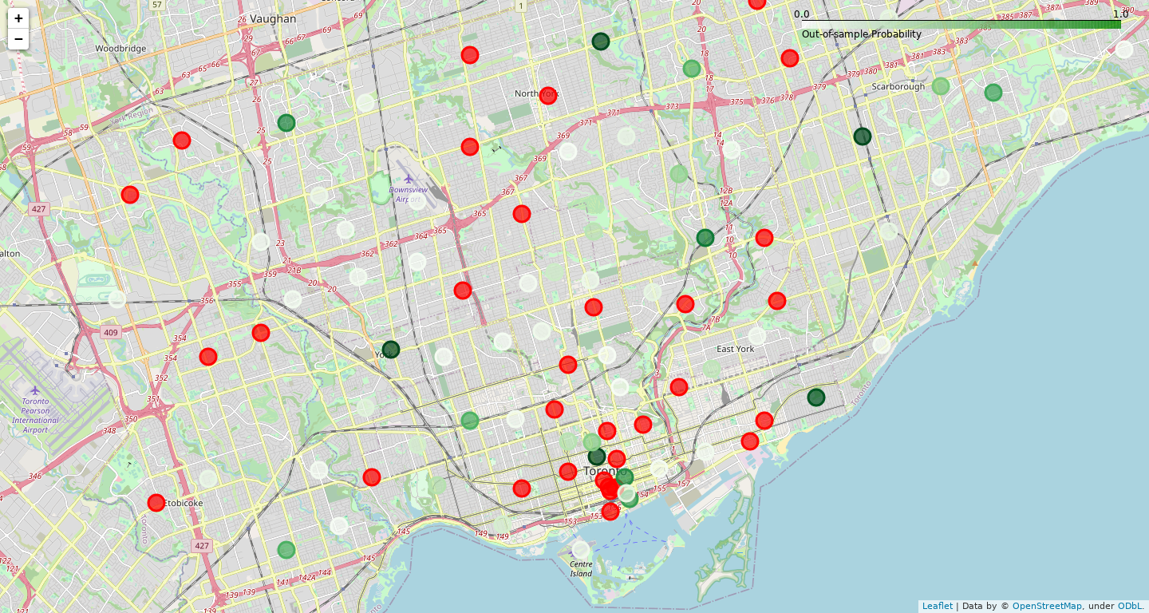
Using Out-of-Sample
Logistic Regression

Slide 5
Sample Weights
Metric | Weight
Sandwich Place | 0.795417
Pharmacy | 0.629754
Pub | 0.583500
Furniture / Home Store | 0.527276
Turkish Restaurant | -0.439646
Coffee Shop | 0.429255
Gym | 0.390059
Health Food Store | -0.383757
Cosmetics Shop | 0.379041
Fried Chicken Joint | 0.345571

Slide 6
Top Potential Locations
Postal Code | In-Sample Probability | Out-of-sample Probability | Dissimilarity | Nearest Postal Code with Pizza (km) | Neighborhood
M5G | 0.033071 | 0.997994 | 0.329618 | 0.686905 | Central Bay Street
M6M | 0.044773 | 0.995333 | 0.232999 | 3.229201 | Del Ray, Mount Dennis, Keelsdale and Silverthorn
M1P | 0.031477 | 0.981079 | 0.267255 | 3.670913 | Dorset Park, Wexford Heights, Scarborough Town...
M2K | 0.069854 | 0.977398 | 0.149123 | 2.604181 | Bayview Village
M4E | 0.040721 | 0.949181 | 0.191652 | 1.993202 | The Beaches
M3C | 0.018529 | 0.820855 | 0.322462 | 2.042678 | Don Mills
M3N | 0.028106 | 0.771850 | 0.201540 | 3.669023 | Downsview
M5C | 0.008841 | 0.741657 | 0.732204 | 0.509909 | St. James Town
M5E | 0.011825 | 0.679016 | 0.563662 | 0.648805 | Berczy Park
M1B | 0.040601 | 0.662348 | 0.112884 | 9.276343 | Malvern, Rouge

